Slide 1
Machine Learning 2024 (ML-2024) Lecture 9. Recurrent neural networks
by Alexei Valerievich Kornaev, Dr. habil. in Eng. Sc., Researcher at the RC for AI, Assoc. Prof. of the Robotics and CV Master’s Program, Innopolis University
Researcher at the RC for AI, National RC for Oncology n.a. NN Blohin
Professor at the Dept. of Mechatronics, Mechanics, and Robotics, Orel State University

Slide 2
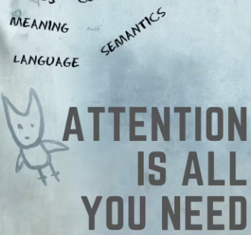

Agenda
ML-2024 by Alexei Kornaev
TEMPORAL DATA PROCESSING INTUITION
RECURRENT NEURAL NETWORKS (RNNs)
TRANSFORMERS (Ts)

Slide 3
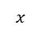
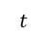
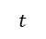
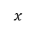
ML-2024 by Alexei Kornaev
Why sequence processing is a challenging problem?
$$x$$
$$t$$
$$t$$
Model
$$x$$
3

Slide 4
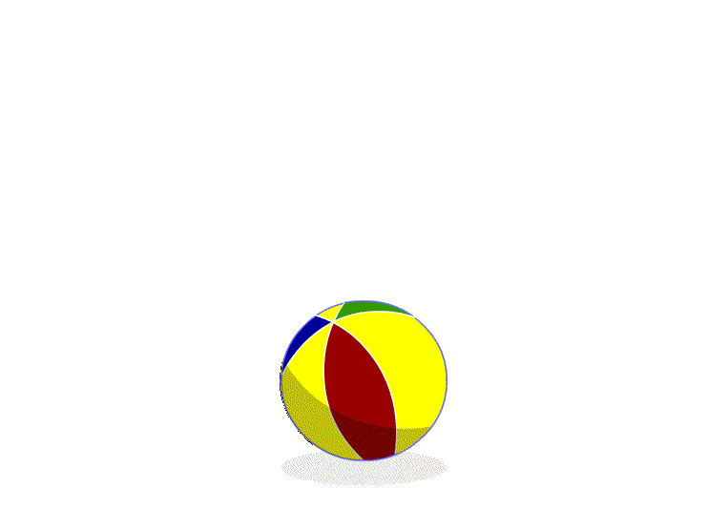
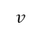
ML-2024 by Alexei Kornaev
Why sequence processing is a challenging problem?
$$x$$
$$t$$
$$x$$
Model
$$v$$
4

Slide 5
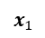
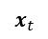
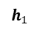
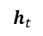
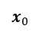
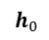
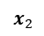
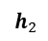
ML-2024 by Alexei Kornaev
Sequence modeling intuition
$$x_{t}$$
$$x_{0}$$
$$x_{1}$$
$$x_{2}$$
Model
Model
Model
Model
$$h_{t}$$
$$h_{0}$$
$$h_{1}$$
$$h_{2}$$
MIT 6.S191: Recurrent Neural Networks, Transformers, and Attention
5

Slide 6

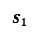
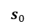
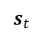
ML-2024 by Alexei Kornaev
Sequence modeling intuition
$$x_{t}$$
$$x_{0}$$
$$x_{1}$$
$$x_{2}$$
Model
Model
Model
Model
$$s_{t}$$
$$s_{0}$$
$$s_{1}$$
$$h_{t}$$
$$h_{0}$$
$$h_{1}$$
$$h_{2}$$
$$h_{t}=\left(\begin{matrix}x_{t}, & s_{t−1}\end{matrix}\right)$$
MIT 6.S191: Recurrent Neural Networks, Transformers, and Attention
6

Slide 7
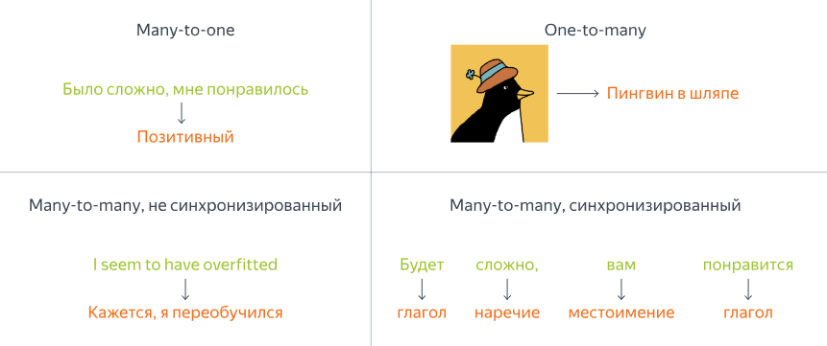
ML-2024 by Alexei Kornaev
Sequence modeling applications
Yandex Handbook on ML
7

Slide 8
Agenda
ML-2024 by Alexei Kornaev
TEMPORAL DATA PROCESSING INTUITION
RECURRENT NEURAL NETWORKS (RNNs)
TRANSFORMERS (Ts)

Slide 9
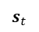

ML-2024 by Alexei Kornaev
RNNs intuition: apply a recurrence relation to process a sequence
$$x_{t}$$
$$x_{0}$$
$$x_{1}$$
$$x_{2}$$
Model
Model
Model
Model
$$s_{t}$$
$$s_{0}$$
$$s_{1}$$
$$h_{t}$$
$$h_{0}$$
$$h_{1}$$
$$h_{2}$$
$$s_{t}=\left(\begin{matrix}x_{t}, & s_{t−1}\end{matrix}\right)$$
MIT 6.S191: Recurrent Neural Networks, Transformers, and Attention
9

Slide 10
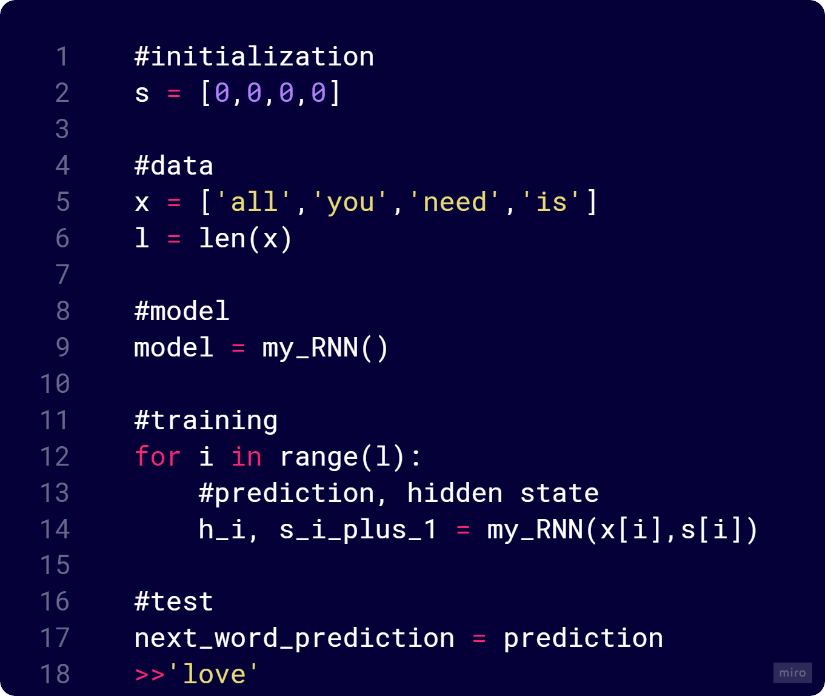
ML-2024 by Alexei Kornaev
RNNs intuition: apply a recurrence relation to process a sequence
$$x_{t}$$
Model
$$s_{t}$$
$$h_{t}$$
MIT 6.S191: Recurrent Neural Networks, Transformers, and Attention
10

Slide 11
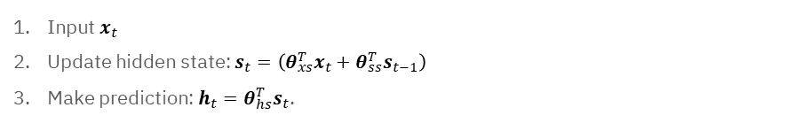
ML-2024 by Alexei Kornaev
RNNs intuition: apply a recurrence relation to process a sequence
$$x_{t}$$
Input $x_{t}$
Update hidden state: $s_{t}=\left({θ_{xs}^{T}x}_{t}+{θ_{ss}^{T}s}_{t−1}\right)$
Make prediction: $h_{t}={θ_{hs}^{T}s}_{t}$.
Model
$$s_{t}$$
$$h_{t}$$
MIT 6.S191: Recurrent Neural Networks, Transformers, and Attention
11

Slide 12
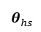
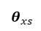
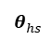
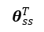
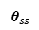
ML-2024 by Alexei Kornaev
RNNs intuition: apply a recurrence relation to process a sequence
$$x_{t}$$
$$x_{0}$$
$$x_{1}$$
$$x_{2}$$
$$θ_{xs}^{}$$
$$θ_{xs}^{}$$
$$θ_{xs}^{}$$
Model
Model
Model
Model
$$s_{0}$$
$$s_{1}$$
$$s_{t}$$
$$θ_{ss}^{}$$
$$θ_{ss}^{T}$$
$$θ_{hs}^{}$$
$$θ_{hs}^{}$$
$$θ_{hs}^{}$$
$$h_{t}$$
$$h_{0}$$
$$h_{1}$$
$$h_{2}$$
The model re-uses same weight matrices at every time step
MIT 6.S191: Recurrent Neural Networks, Transformers, and Attention
12

Slide 13
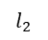
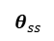
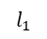
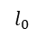
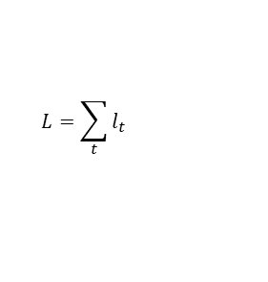
ML-2024 by Alexei Kornaev
RNNs gradient flow: exploding and vanishing gradients
Many values < 1: vanishing
Activation functions
Weights initialization
Network architecture
$$x_{t}$$
$$x_{0}$$
$$x_{1}$$
$$x_{2}$$
$$θ_{xs}^{}$$
$$θ_{xs}^{}$$
$$θ_{xs}^{}$$
Model
Model
Model
Model
$$s_{0}$$
$$s_{1}$$
$$s_{t}$$
$$θ_{ss}^{}$$
$$θ_{ss}^{}$$
$$θ_{hs}^{}$$
$$θ_{hs}^{}$$
$$θ_{hs}^{}$$
$$h_{t}$$
$$h_{0}$$
$$h_{1}$$
$$h_{2}$$
$$L=\sum_{t}{l_{t}}$$
$$l_{0}$$
$$l_{1}$$
$$l_{2}$$
Many values > 1: exploding
Gradient clipping to scale big gradients
MIT 6.S191: Recurrent Neural Networks, Transformers, and Attention
13

Slide 14
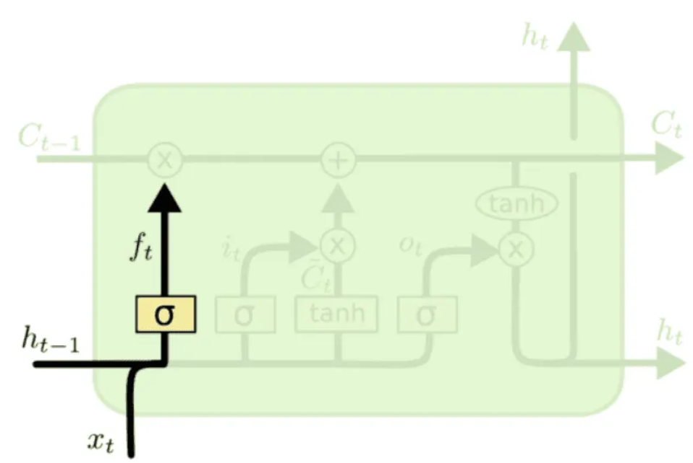
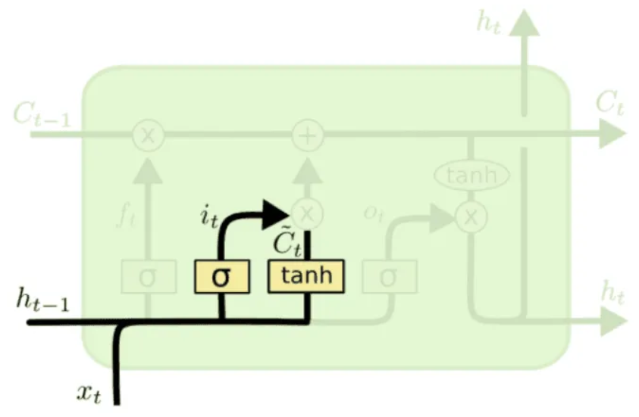
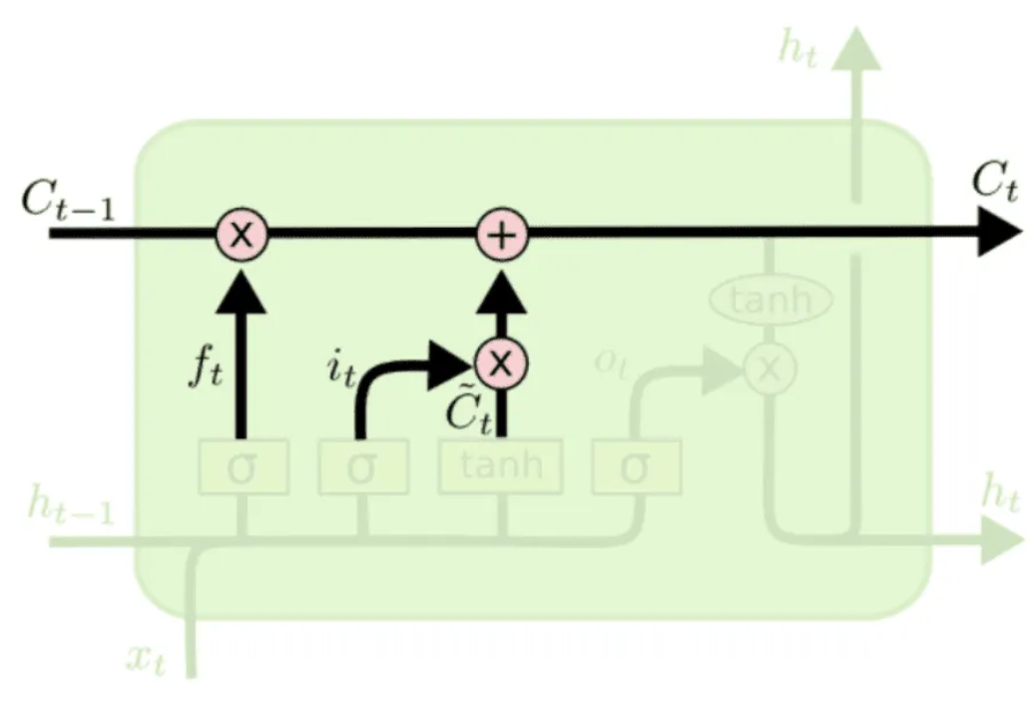
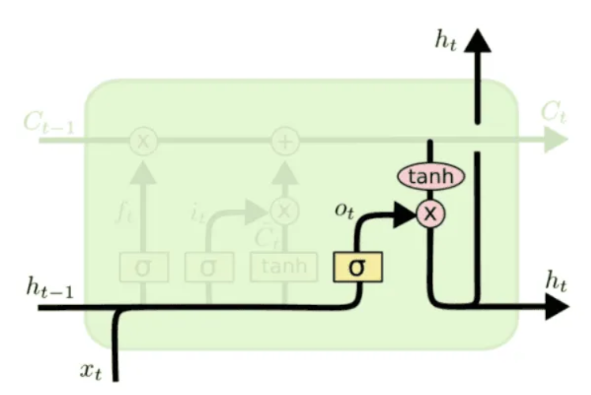
ML-2024 by Alexei Kornaev
Long short-term memory networks (LSTMs): forget, store, update, output gates
Understanding-LSTMs
14

Slide 15
ML-2024 by Alexei Kornaev
Why recurrent neural networks (RNNs) are good at sequences processing?
Sequential Memory: RNNs have a built-in memory mechanism that allows them to maintain information across time steps. This is crucial for tasks where the context from previous time steps is important for making predictions at the current time step.
Variable-Length Inputs: Unlike traditional neural networks, RNNs can handle sequences of variable lengths. This flexibility is essential for processing data where the length of the input sequence can vary, such as sentences in natural language or time series data.
Contextual Understanding: RNNs can capture dependencies and patterns in the data that span multiple time steps. This is particularly useful in tasks like language modeling, where understanding the context of a word often requires looking at the words that come before it.
Stateful Processing: RNNs can maintain a hidden state that summarizes the information from previous time steps. This stateful processing allows RNNs to model long-term dependencies in the data.
Versatility: RNNs can be adapted for various tasks by modifying their architecture. For example, Long Short-Term Memory (LSTM) networks and Gated Recurrent Units (GRUs) are specialized types of RNNs designed to better capture long-range dependencies and mitigate the vanishing gradient problem.
DeepSeek-V2.5 speaks
15

Slide 16
Agenda
ML-2024 by Alexei Kornaev
TEMPORAL DATA PROCESSING INTUITION
RECURRENT NEURAL NETWORKS (RNNs)
TRANSFORMERS (Ts)

Slide 17
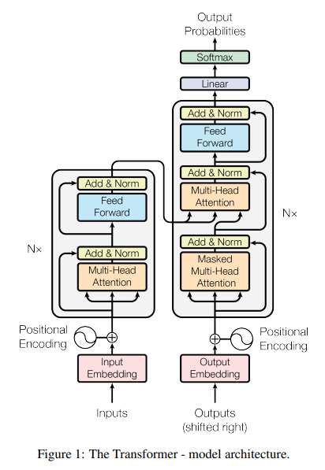
ML-2024 by Alexei Kornaev
Transformer is a game changer
Attention is all you need, 2017
17

Slide 18
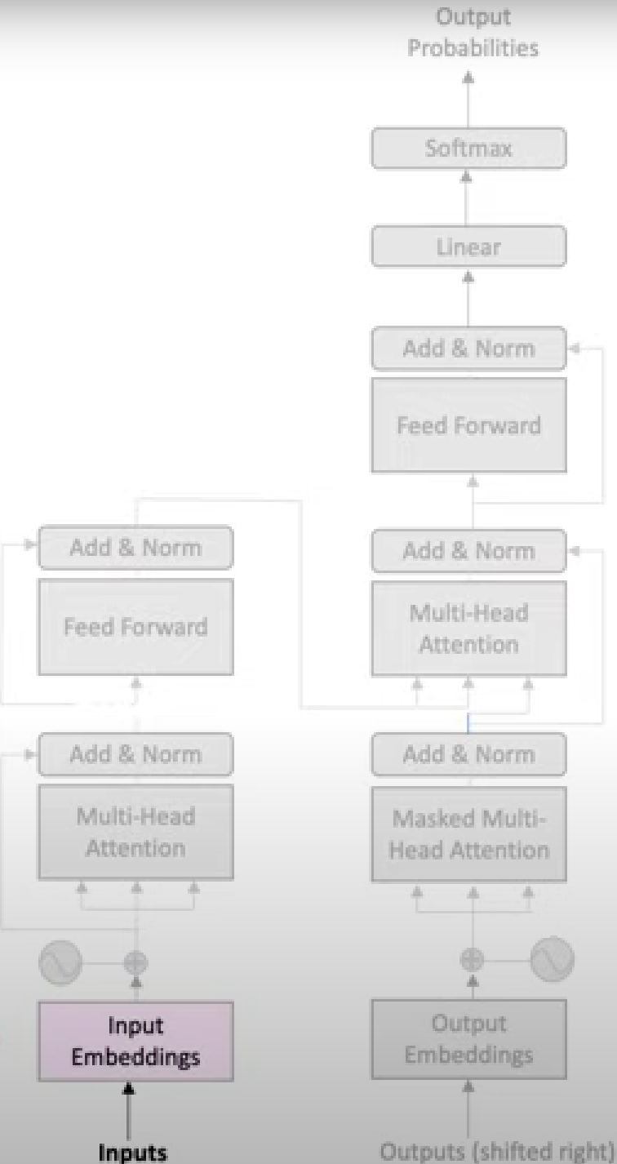
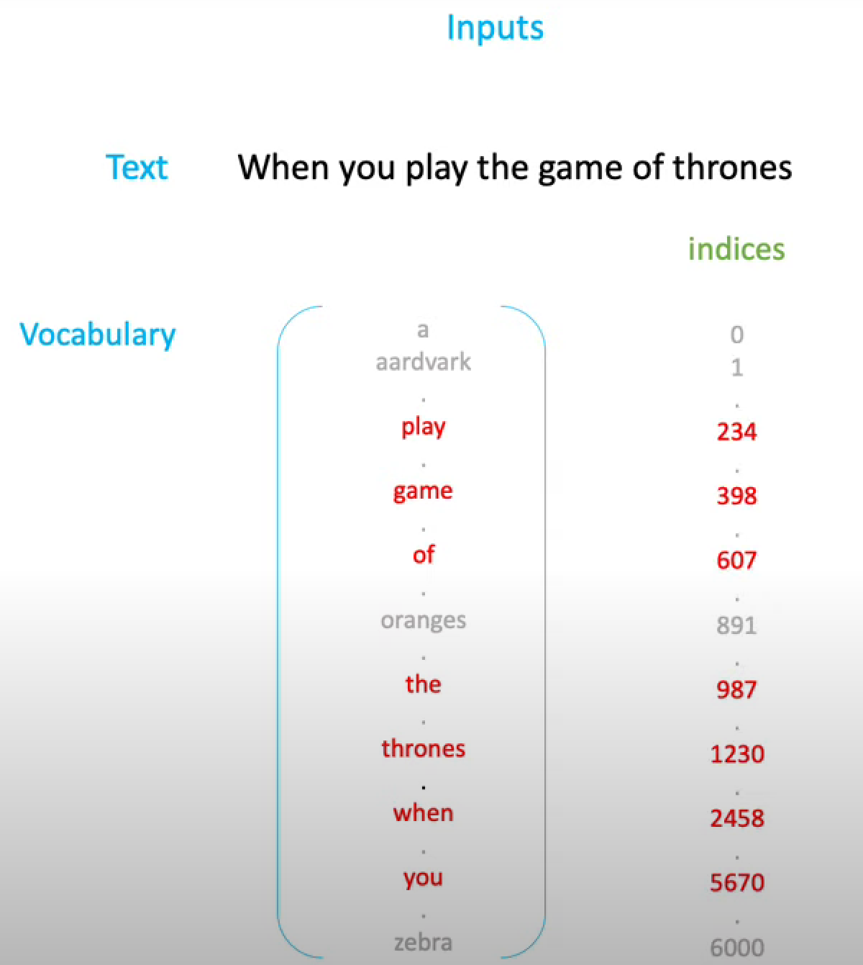
ML-2024 by Alexei Kornaev
Inputs to tokens and embeddings
Visual guide to Transformers
18

Slide 19
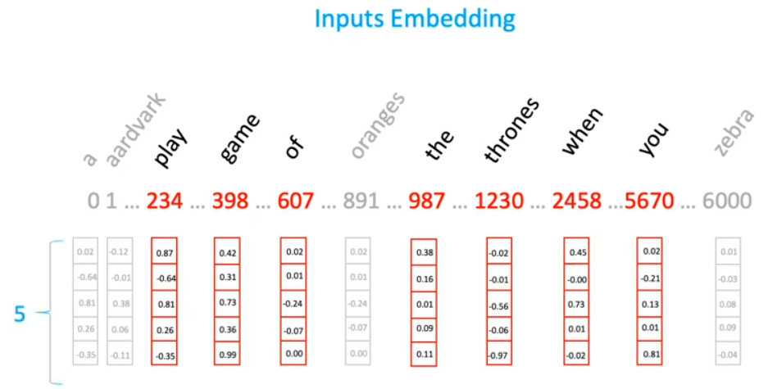
ML-2024 by Alexei Kornaev
Inputs to tokens and embeddings
Visual guide to Transformers
19

Slide 20
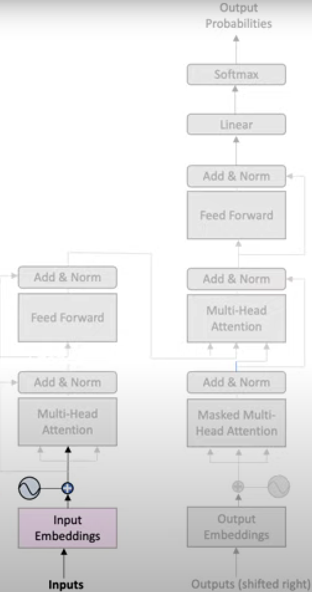
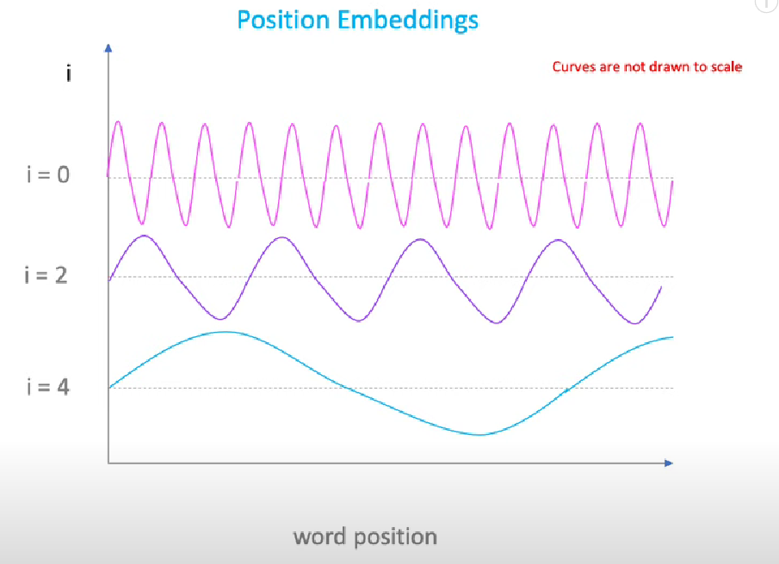
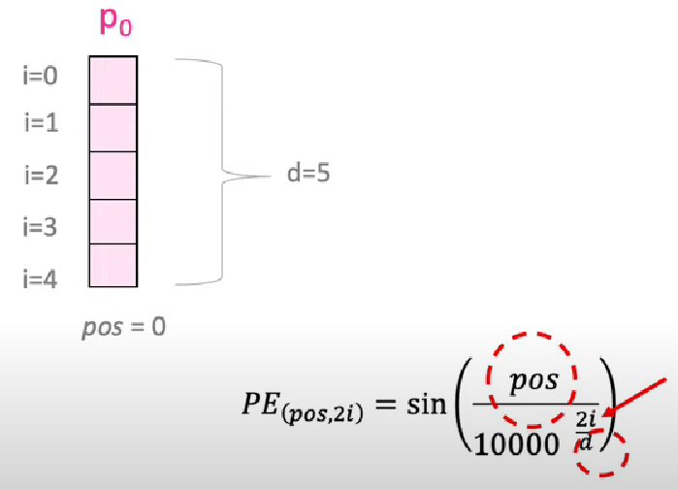
ML-2024 by Alexei Kornaev
Positional encoding
Visual guide to Transformers
20

Slide 21
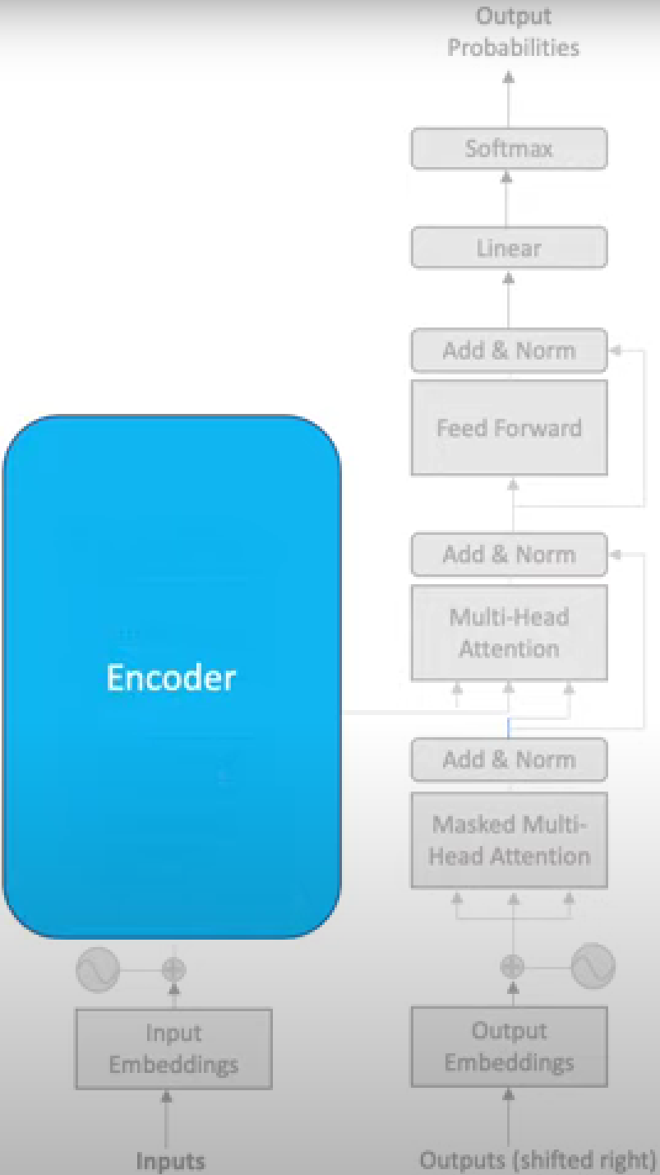
ML-2024 by Alexei Kornaev
T encoder and self-attention intuition
Visual guide to Transformers
21

Slide 22
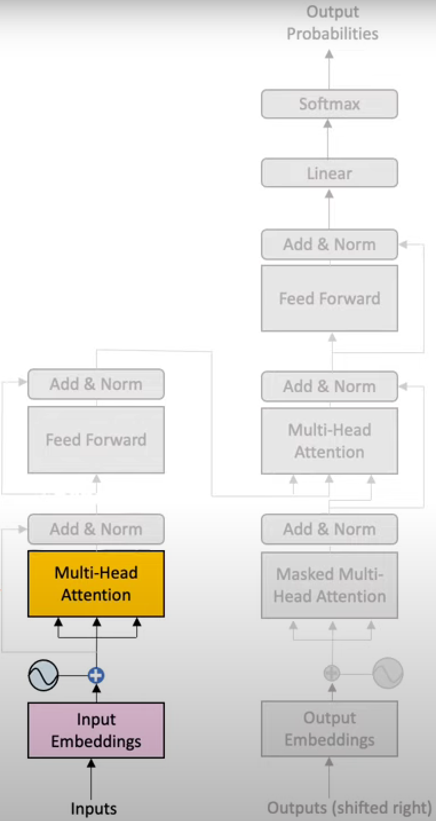
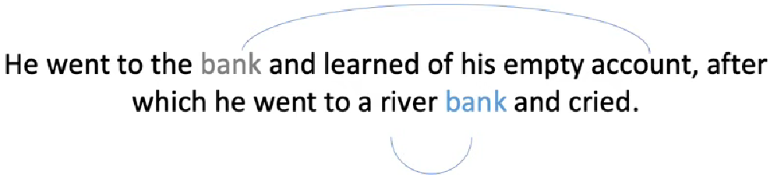
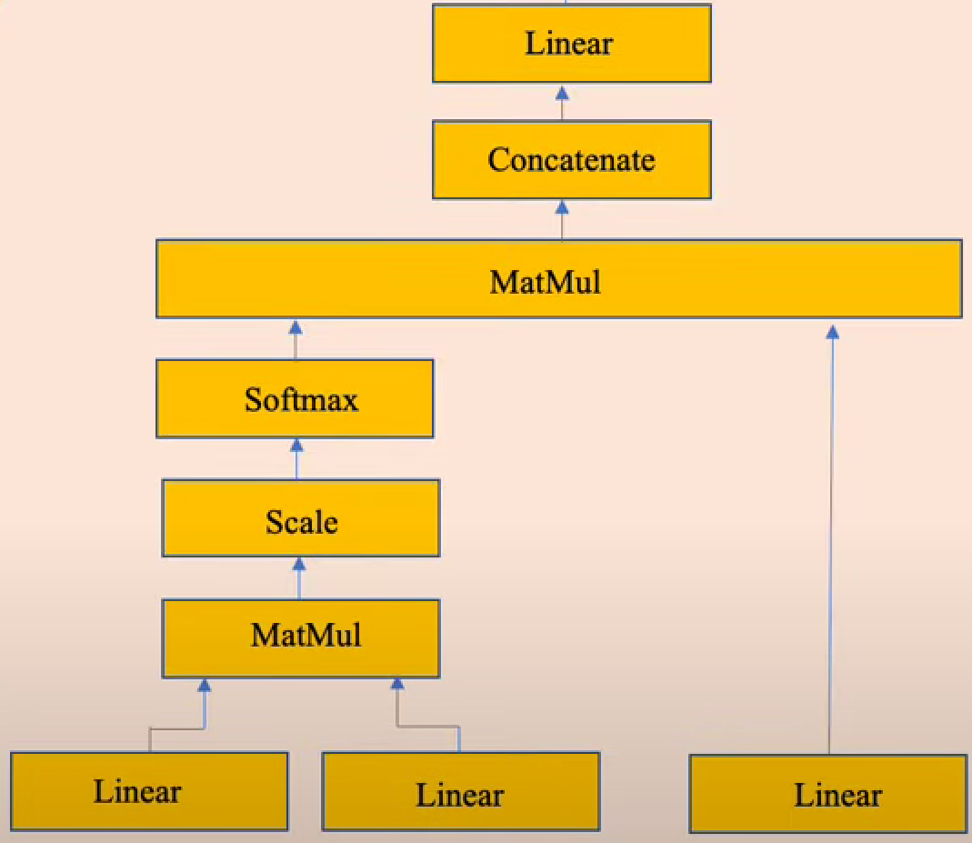
ML-2024 by Alexei Kornaev
T encoder and self-attention intuition
Visual guide to Transformers
22

Slide 23
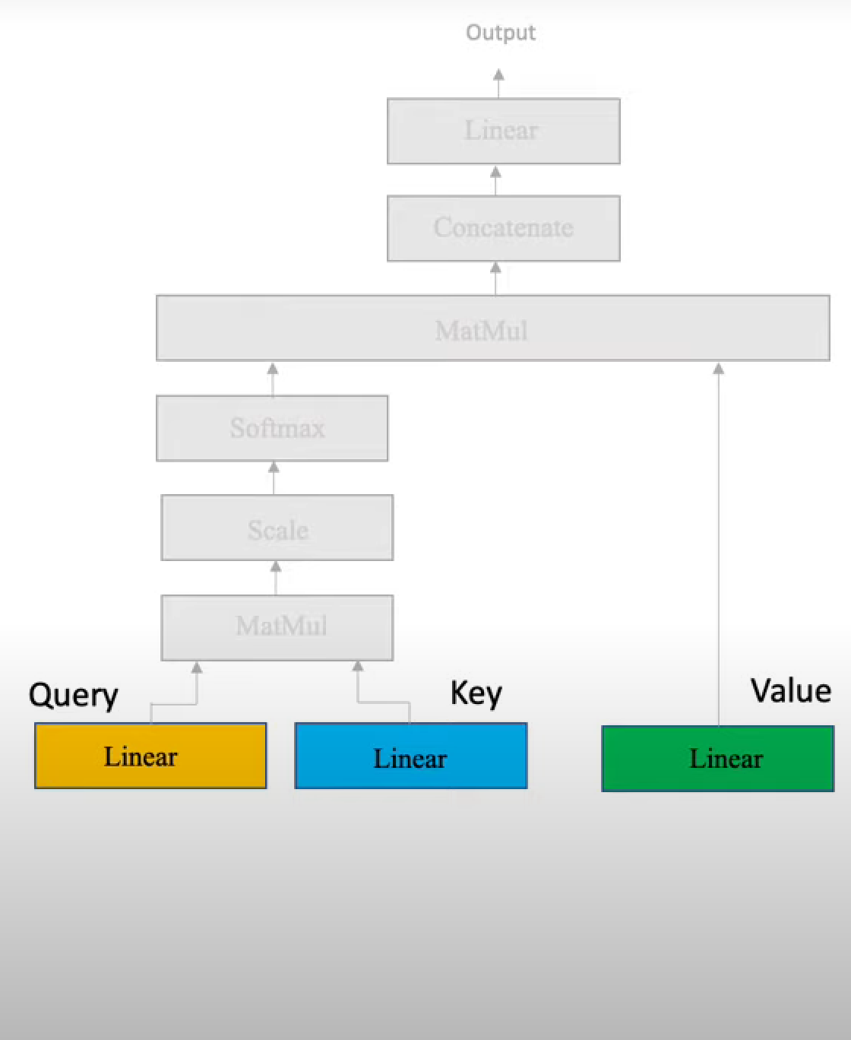
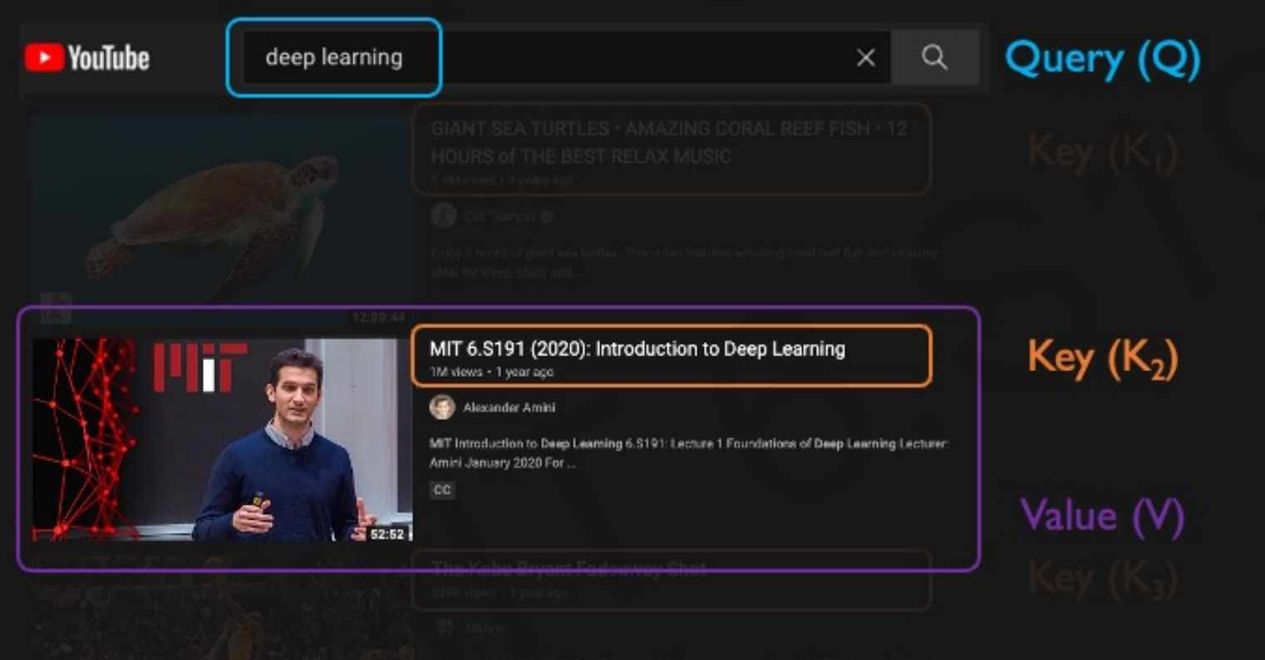
ML-2024 by Alexei Kornaev
Self-attention intuition
Visual guide to Transformers
MIT 6.S191: Recurrent Neural Networks, Transformers, and Attention
23

Slide 24
ML-2024 by Alexei Kornaev
Self-attention intuition
when
you
play
the
game
of
thrones
Visual guide to Transformers
24

Slide 25
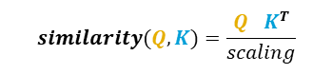
ML-2024 by Alexei Kornaev
Self-attention intuition
when
you
play
the
game
of
thrones
$$similarity(Q,K)=\frac{Q^{}K^{T}}{scaling}$$
Visual guide to Transformers
25

Slide 26

when
you
play
the
game
of
thrones
ML-2024 by Alexei Kornaev
Self-attention intuition
when
you
play
the
game
of
thrones
$$similarity\left(Q,K\right)=\frac{Q^{}K^{T}}{scaling}=$$
Visual guide to Transformers
26

Slide 27

ML-2024 by Alexei Kornaev
Self-attention intuition
Visual guide to Transformers
27

Slide 28


ML-2024 by Alexei Kornaev
Self-attention intuition
$$Attention\left(Q,K,V\right)= softmax\left(\frac{Q^{}K^{T}}{scaling}\right)V$$
Visual guide to Transformers
28

Slide 29

ML-2024 by Alexei Kornaev
Self-attention intuition
Visual guide to Transformers
29

Slide 30

ML-2024 by Alexei Kornaev
Multi-head attention intuition
Visual guide to Transformers
30

Slide 31
ML-2024 by Alexei Kornaev
Why transformers (Ts) are the best at sequences processing?
Parallel Processing: ransformers process entire sequences in parallel, unlike RNNs which process data sequentially. This parallelism significantly speeds up training and inference times.
Attention Mechanism: The core innovation of Transformers is the self-attention mechanism, which allows the model to weigh the importance of different elements in the input sequence when making predictions. This mechanism helps in capturing long-range dependencies more effectively.
Handling Long-Range Dependencies: Transformers can capture long-range dependencies more effectively than RNNs. The self-attention mechanism ensures that distant elements in the sequence can influence each other directly, without the need for intermediate steps. Unlike RNNs, which suffer from the vanishing gradient problem, Transformers do not have this issue due to their parallel processing and attention mechanism.
Scalability: Transformers can be scaled to handle very large datasets and complex tasks. The attention mechanism allows for the incorporation of more data without a significant increase in computational complexity.
Versatility: Transformers can be adapted for a wide range of sequence processing tasks, including natural language processing, speech recognition, and even computer vision (e.g., Vision Transformers).
State-of-the-Art Performance
DeepSeek-V2.5 speaks
31

Slide 32

ML-2024 by Alexei Kornaev
Thank you for your attention!
a.kornaev@innopolis.ru, @avkornaev

Slide 33
ML-2024 Notes
33

Slide 34
ML-2024 Notes
34

Slide 35
ML-2024 Notes
35

